Slide 1
Name: MERIT ORIAGHEMUORIA course :WEB DESIGN
DATE: 18TH FEBRUARY, 2020
SUPERVISED BY: FACULTY MOSES

Slide 2
TABLE OF CONTENTS
Introduction
Components of web design
Benefits of Web design
Project Preview/Description
Conclusion

Slide 3
INTRODUCTION
The web is a system of internet servers that support specially formatted documents.
The documents are supported in a markup language called HTML that supports graphics, audio and video files.
A web server however , is the program or machine that responds to requests and delivers the contents of the page back to the client via the browser.
This could be done because every computer or device that connects to the internet has a unique identifying number called Internet Protocol address
A web page is a hypertext document connected to the WWW
Website is a collection of webpages of related contents.

Slide 4
COMPONENTS OF WEB DESIGN
Web design encompasses many different skills and disciplines in the production and maintenance of websites.
Some areas of web design includes graphic design , interface design, authoring, user experience design and search engine optimization.

Slide 5
TOOLS IN WEB DESIGN
A computer
Text-editor e.g. visual studio code, ATOM
Markup language –HTML
Stylesheet –CSS
Framework -bootstrap
Browser

Slide 6
HYPER TEXT MARKUP LANGAUGE(HTML)
It is used for building the page layout.
It makes use of tags and elements.
A tag is either opening or closing to mark the start or end of an element, while an element is a combination of HTML tags.

Slide 7
CASCADING STYLESHEET
CSS is a styling sheet. It is linked to the HTML. Its used to give design and style to your layout.
Padding, colors , alignment position all are done on your CSS.
CSS framework- BOOTSTRAP is a framework used to make building layouts easier, it has prepared layouts to make your work easier.

Slide 8
WEB DESIGN PROCESS
Analysis
Specification
Coding
Design and development
Content writing
testing

Slide 9
FEATURES OF A GOOD WEBSITE
Search engine optimization
Mobile responsiveness
User experience

Slide 10
BENEFITS OF WEB DESIGN
Generate revenue for companies
It is a source of employment

Slide 11
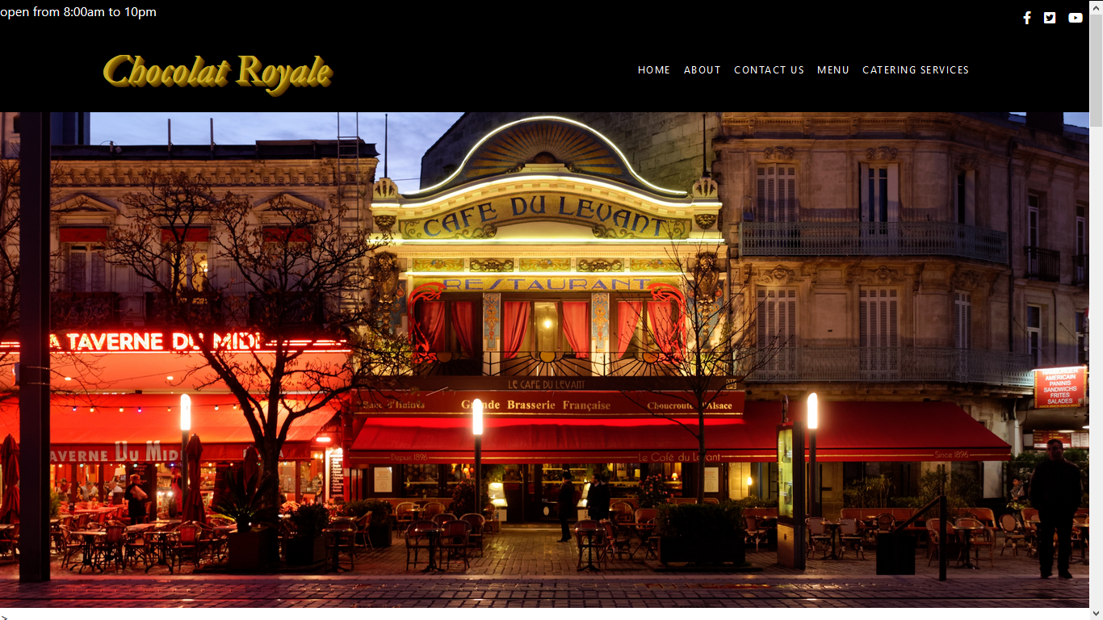
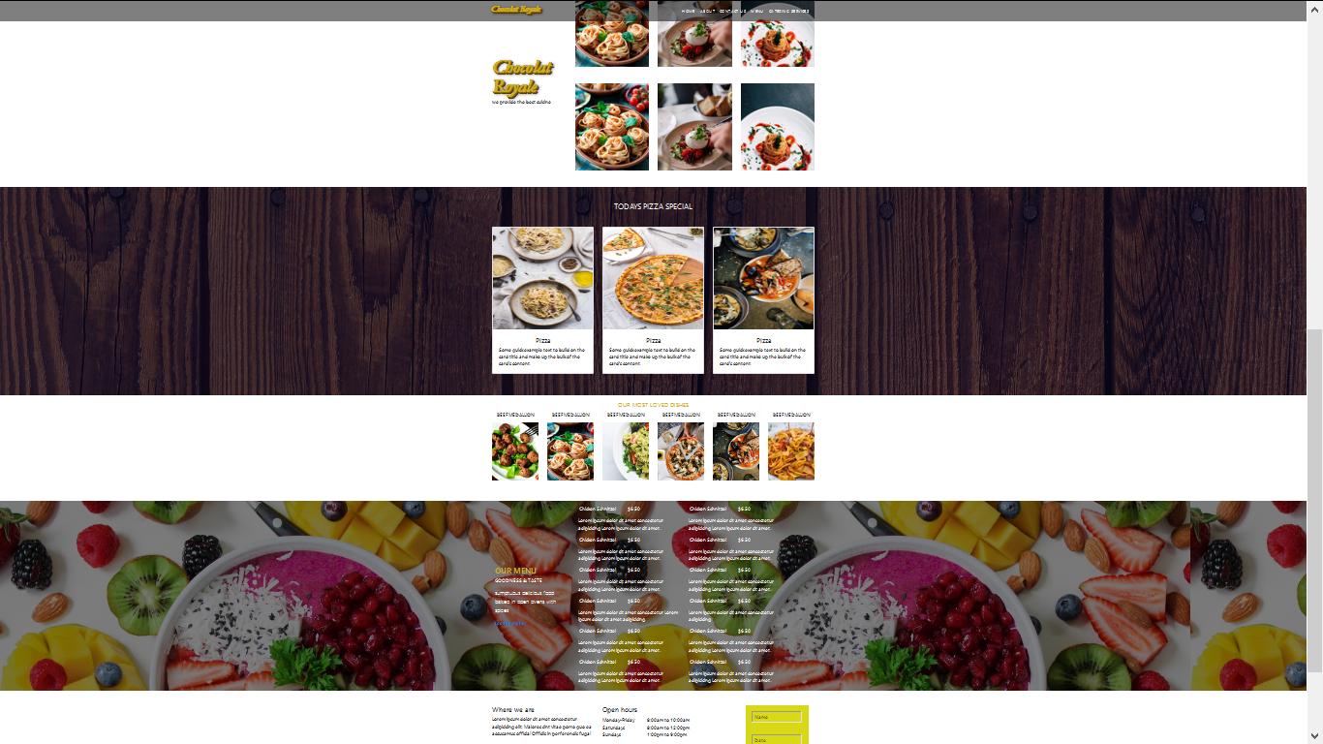
PROJECT PREVIEW/DESCRIPTION
RESTAURANT WEBSITE
CHOCOLAT ROYALE

Slide 12
CONCLUSION
Web design is an innovative technology i.e it is constantly evolving.
It is also a good source of income and revenue.

Slide 13
REFERENCES
http://www.web-source.net
http://www.developmentindia.com
http://en.Wikipedia.org

Slide 14
THANKS FOR LISTENING
Any Questions

